Slide 1


Crop Production Data Analysis:-

Slide 2

Introduction
The provided dataset contains agricultural information for the All district of the and All over State several years. It includes details such as the crop year, season, crop types, area of cultivation, and production quantities. This data is crucial for understanding the agricultural landscape, identifying trends, and making informed decisions related to farming practices, crop selection, and resource allocation.

Slide 3
Details of Data:
Here We have Crop Production Data and all about information Which is provide us to all Related information of Crops And Their Production In Different State or District.
Data Overview:
Summary of the dataset: Number of records, columns, and key variables.
Description of columns:
State_Name.
District_Name.
Crop_Year.
Season.
Crop_Area.
Production

Slide 4
All Related Analysis:
Exploratory Data Analysis (EDA): Understanding the structure and characteristics of the dataset, including summary statistics, distributions, and visualizations.
Crop-wise Analysis: Identifying the most commonly grown crops, analyzing production trends, and determining areas with the highest production for specific crops.
Seasonal Analysis: Comparing crop production between different seasons and identifying crops typically grown during each season.
Yearly Analysis: Analyzing trends in overall agricultural production over the years and identifying significant changes or patterns in crop production from year to year.
Regional Analysis: Exploring variations in crop production across different districts or states and identifying regions with the highest and lowest agricultural productivity.
Forecasting and Planning: Using historical data to forecast future crop production and identify potential risks or challenges to agricultural production, along with strategies to mitigate them.
Business Optimization: Utilizing insights from the data to optimize resource allocation, such as land use or investment in specific crops, and identifying opportunities for diversification or specialization based on market demand and production capabilities.

Slide 5
Analytical Dashboard:

Slide 6
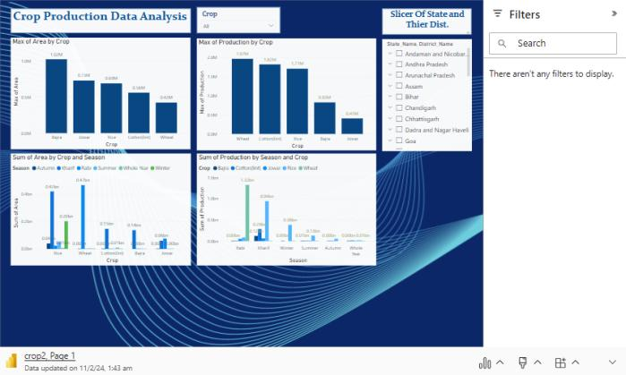
Power Bi Analysis:

Slide 7

Conclusion:
Recap of key insights and findings from the analysis.
Emphasis on the importance of data-driven decision-making in agriculture for sustainable development and food security.
Call to action for stakeholders to utilize the insights gained from the analysis to inform policy-making, investment decisions, and agricultural practices for the benefit of Andaman and Nicobar Islands' agricultural sector.

Slide 8

Thank you

